Slide 1

A Preliminary Exploration on Housing Prices of Haidian District, Beijing
Zhenxing Xie

Slide 2
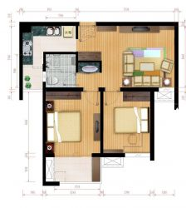
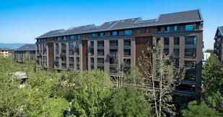
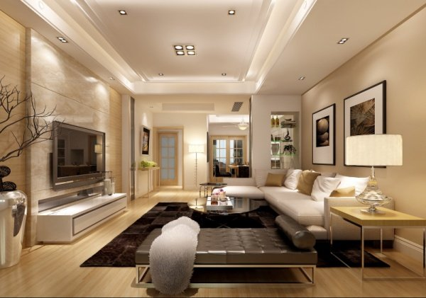
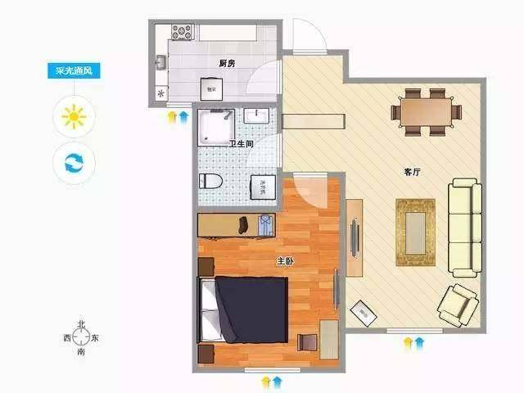
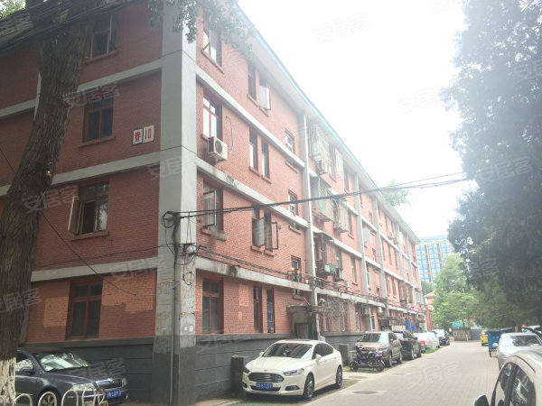
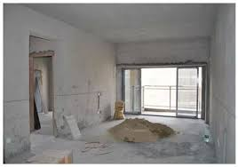
Floor Plan
2B or 1B?
Building Age
Young or Old?
Decoration
Good or Bare Wall?
Question to be asked:
What could be the influential factors on housing prices ?

Slide 3

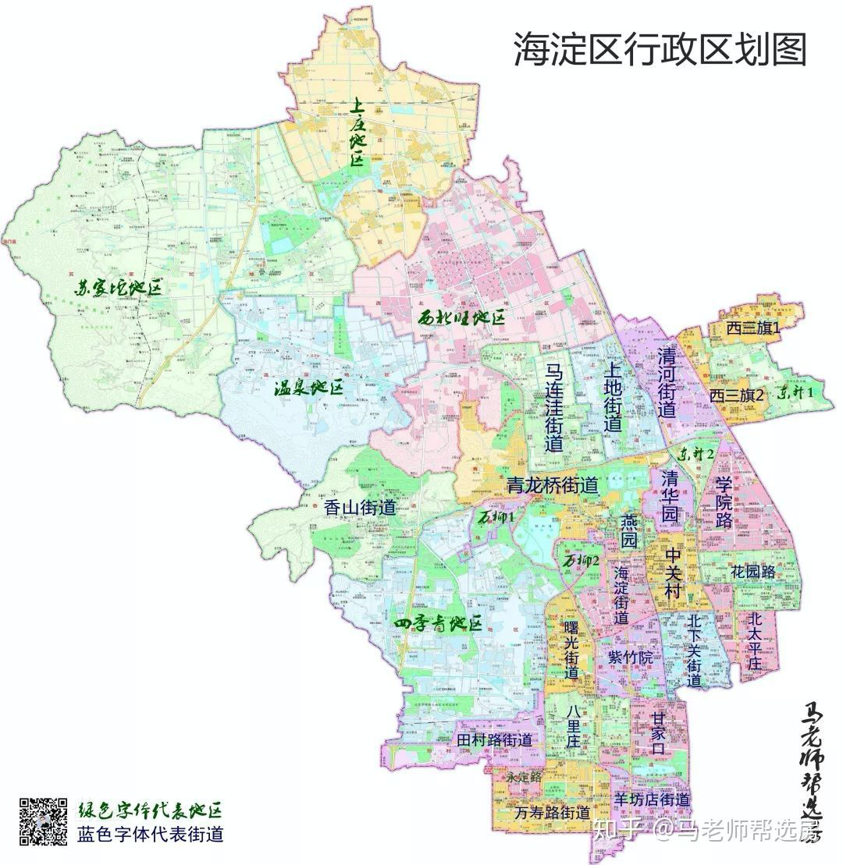
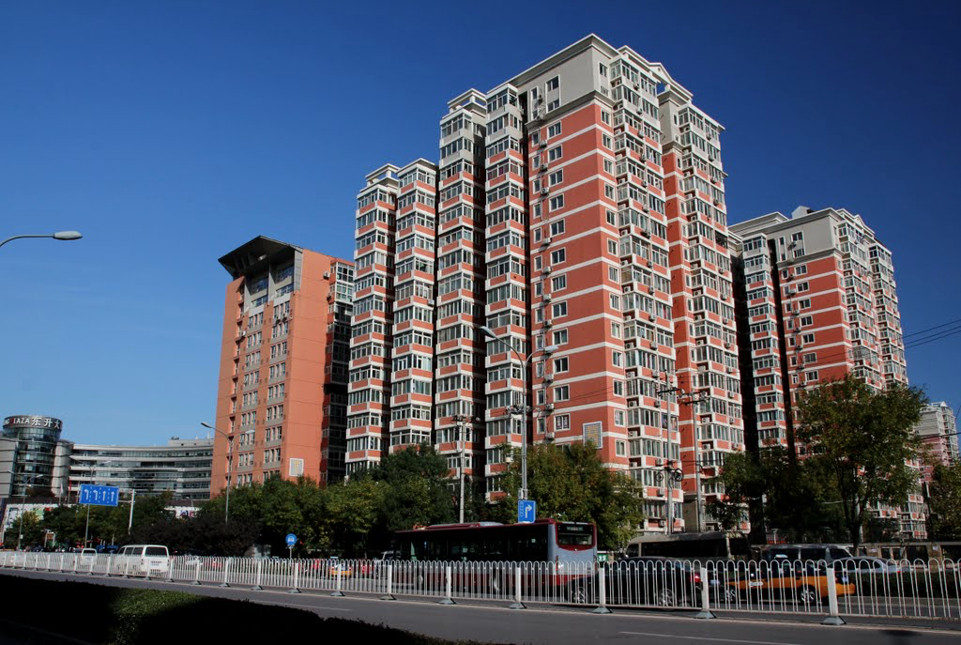
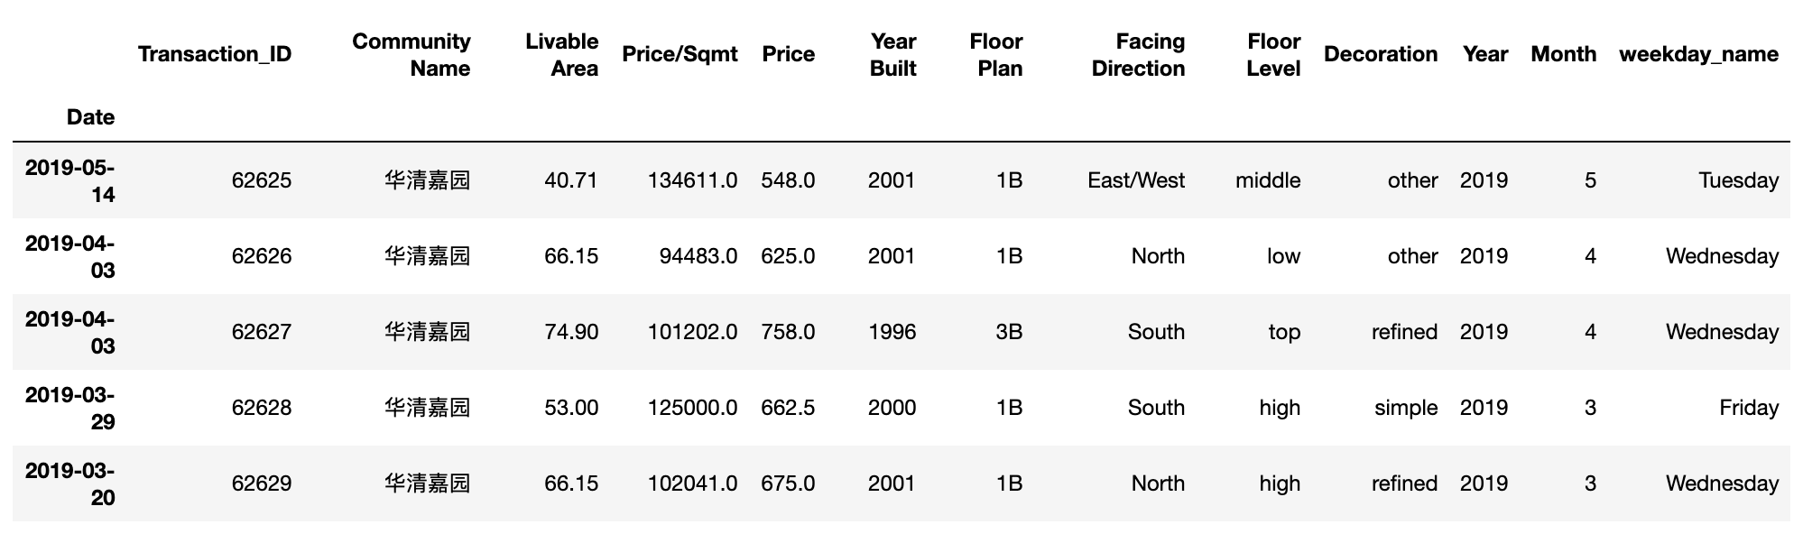
What data looks like ?
Haidian District
Community
Transaction
Records

Slide 4
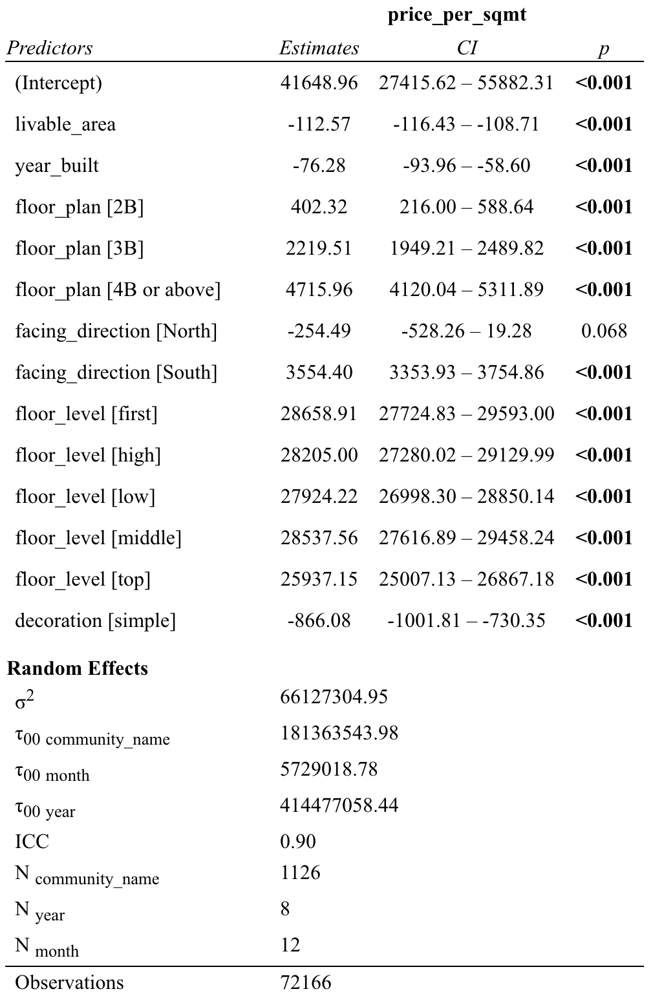

What statistics tells us?

Slide 5
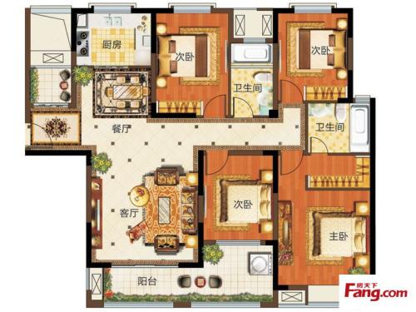
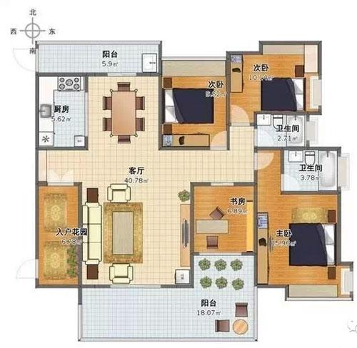
If you want to switch from 1B to 2B, 3B or 4B or above, you will be facing with even higher housing prices per square meter.
Let's say something that ordinary folks can understand.
4B or Above
3B
2B
+4716
+2220
+402
1B

Slide 6
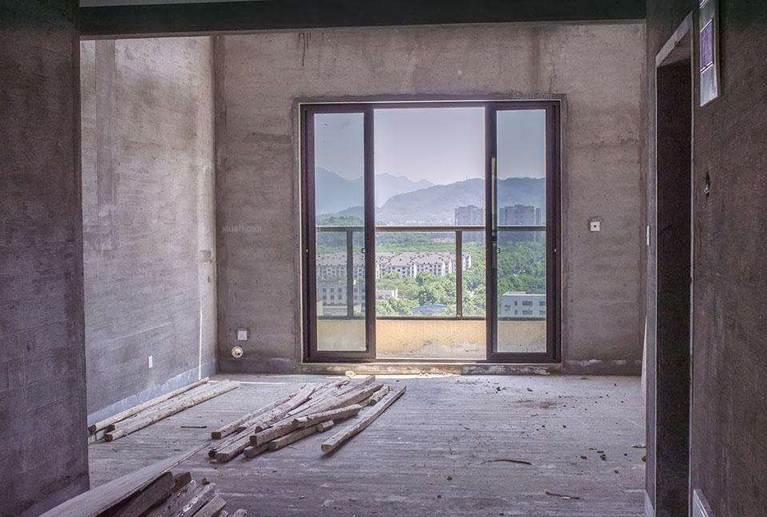
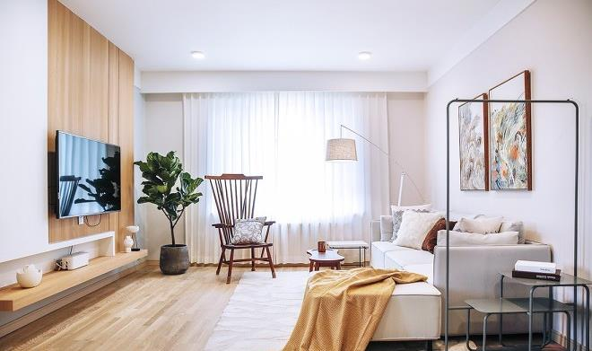
Comparing with buying an apartment with simple decoration, you will pay 866 yuan more for purchasing a refined one in terms of housing prices per square meter.
Let's say something that ordinary folks can understand.

Slide 7
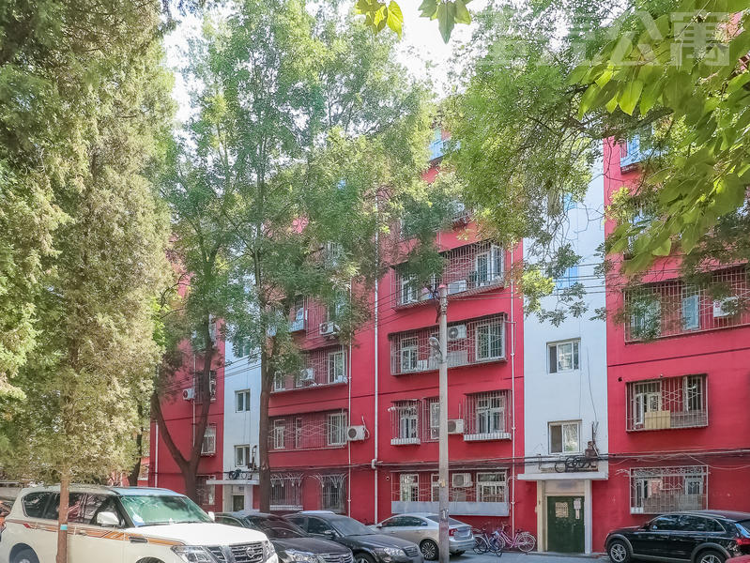
If you want to buy a 40 years-old apartment like the one in the left picture, you will pay 3040(-76*40) yuan less than purchasing a brand new one in terms of housing prices per square meter.
Let's say something that ordinary folks can understand.

Slide 8

Thanks for watching!

